Slide 1
Budget Calculator
Adam Eichman, Hunter Uebelacker, Jake Ferner, EJ Boakye, Michael Emborsky

Slide 2
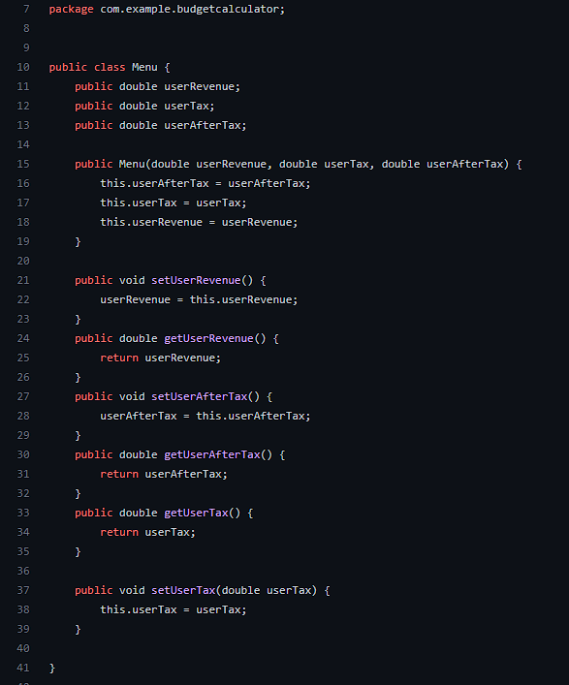
Menu Class

Slide 3
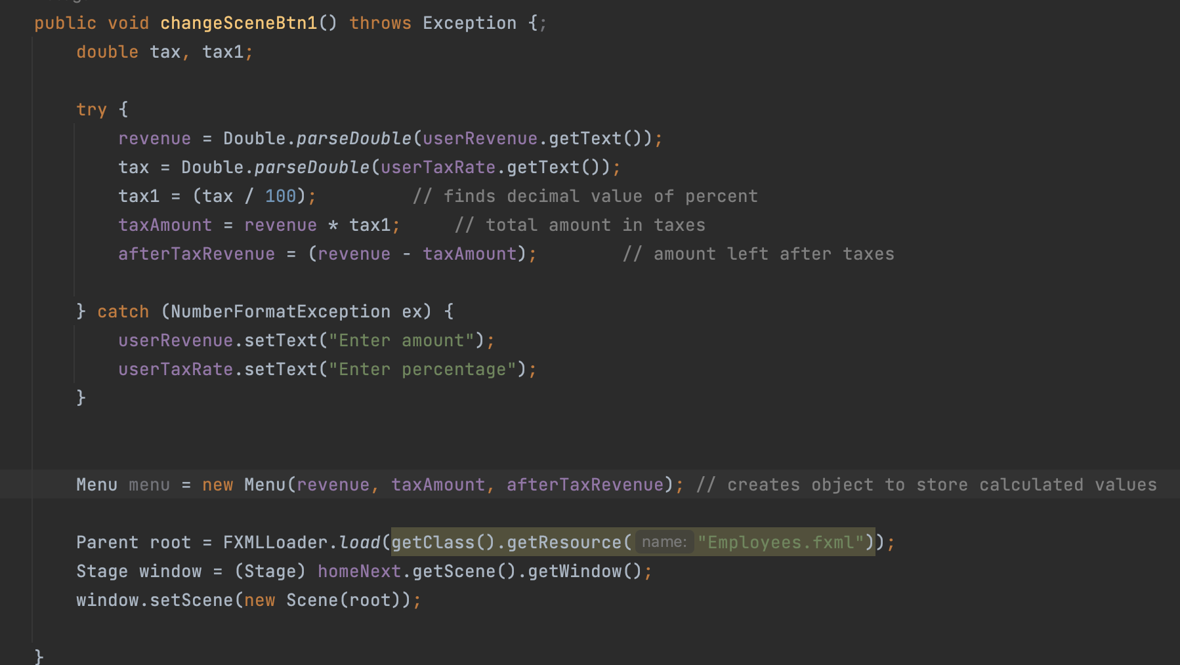
userRevenue and taxRate

Slide 4
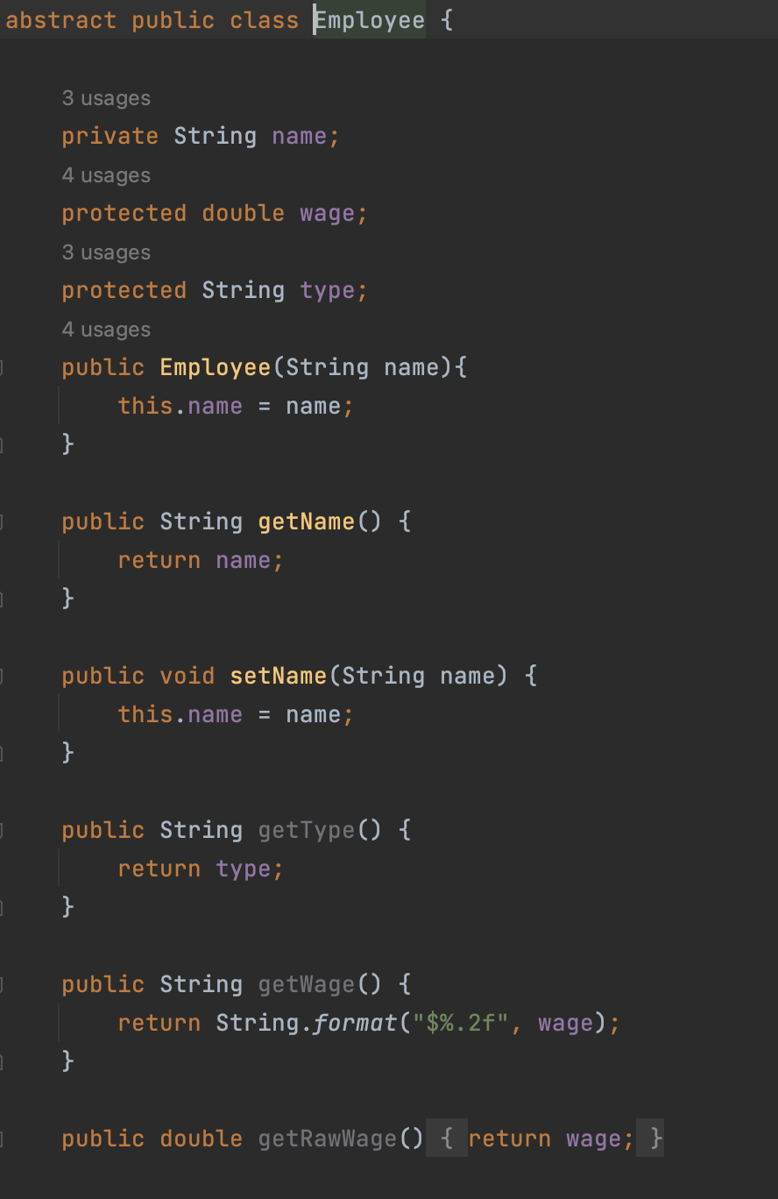
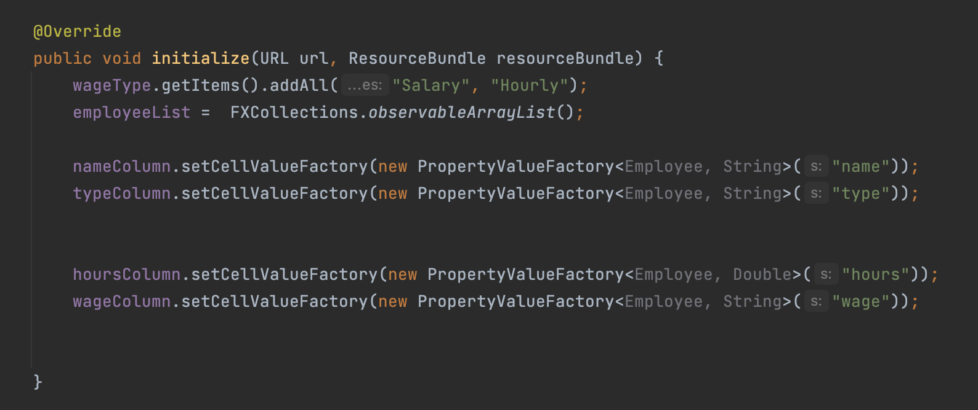
Employee

Slide 5
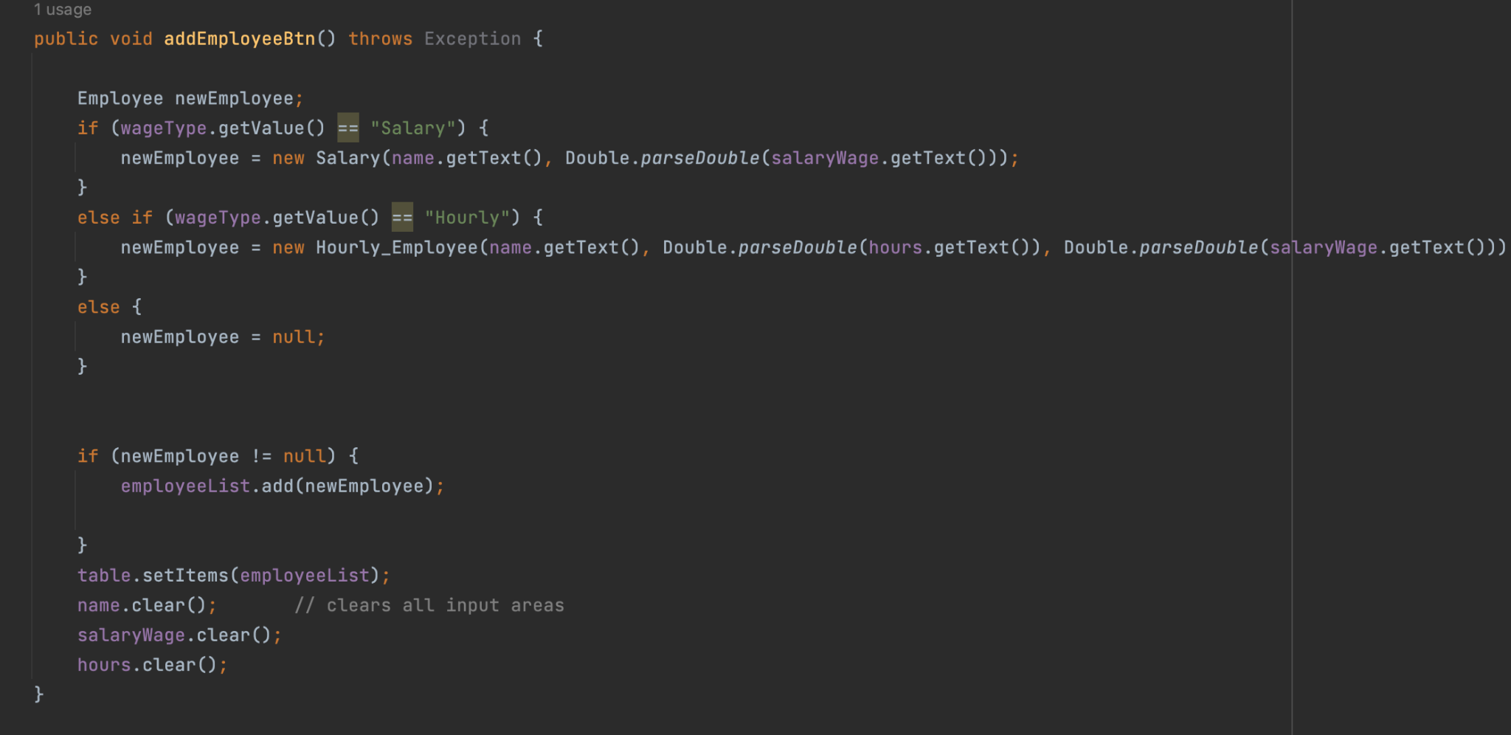
Employee

Slide 6
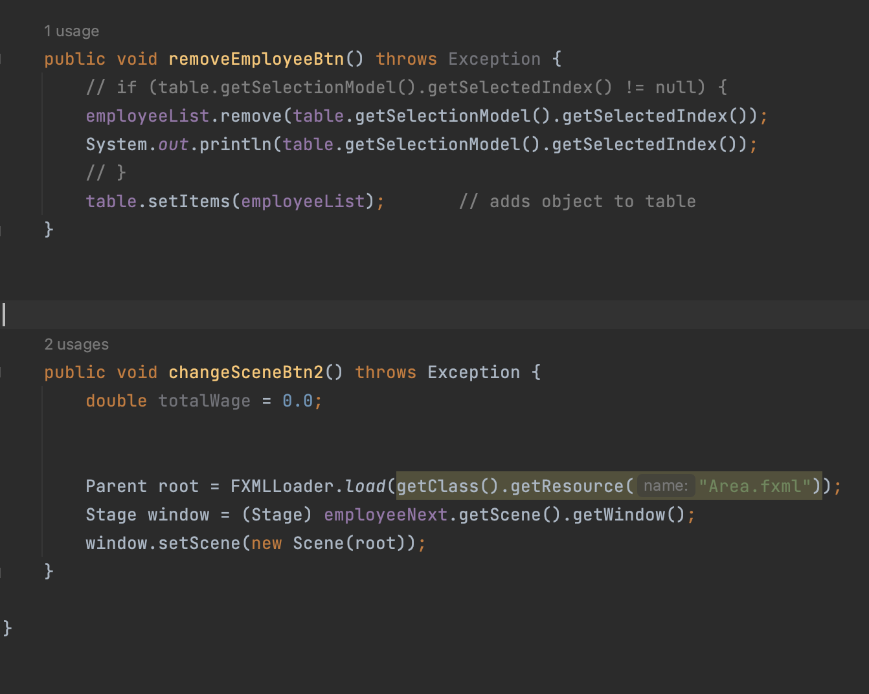
Employee

Slide 7
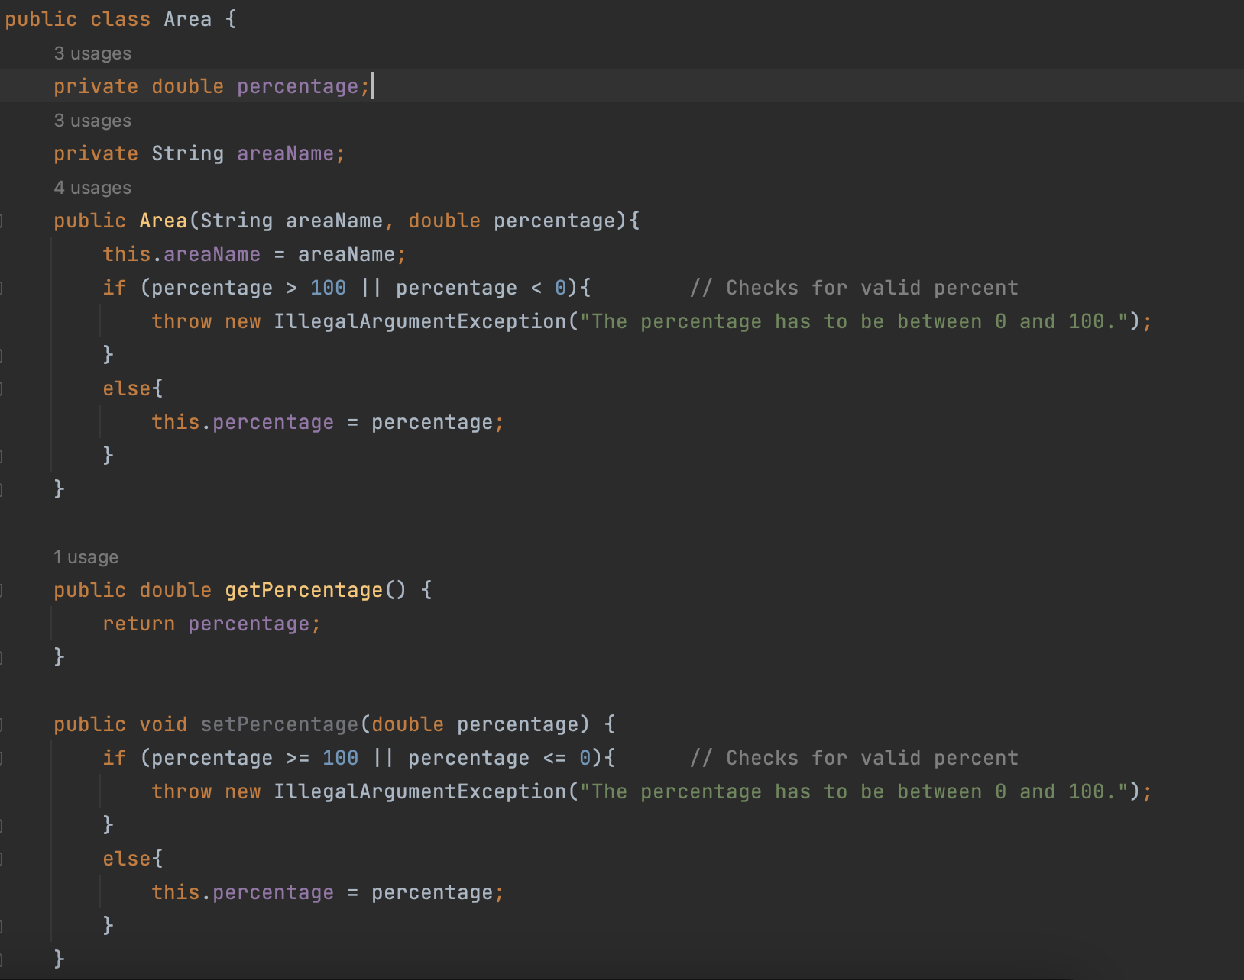
Budget Area

Slide 8
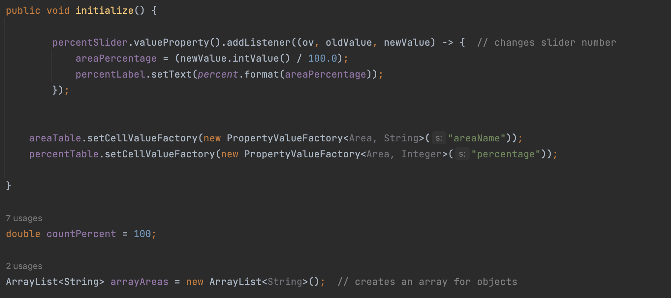
Budget Area

Slide 9
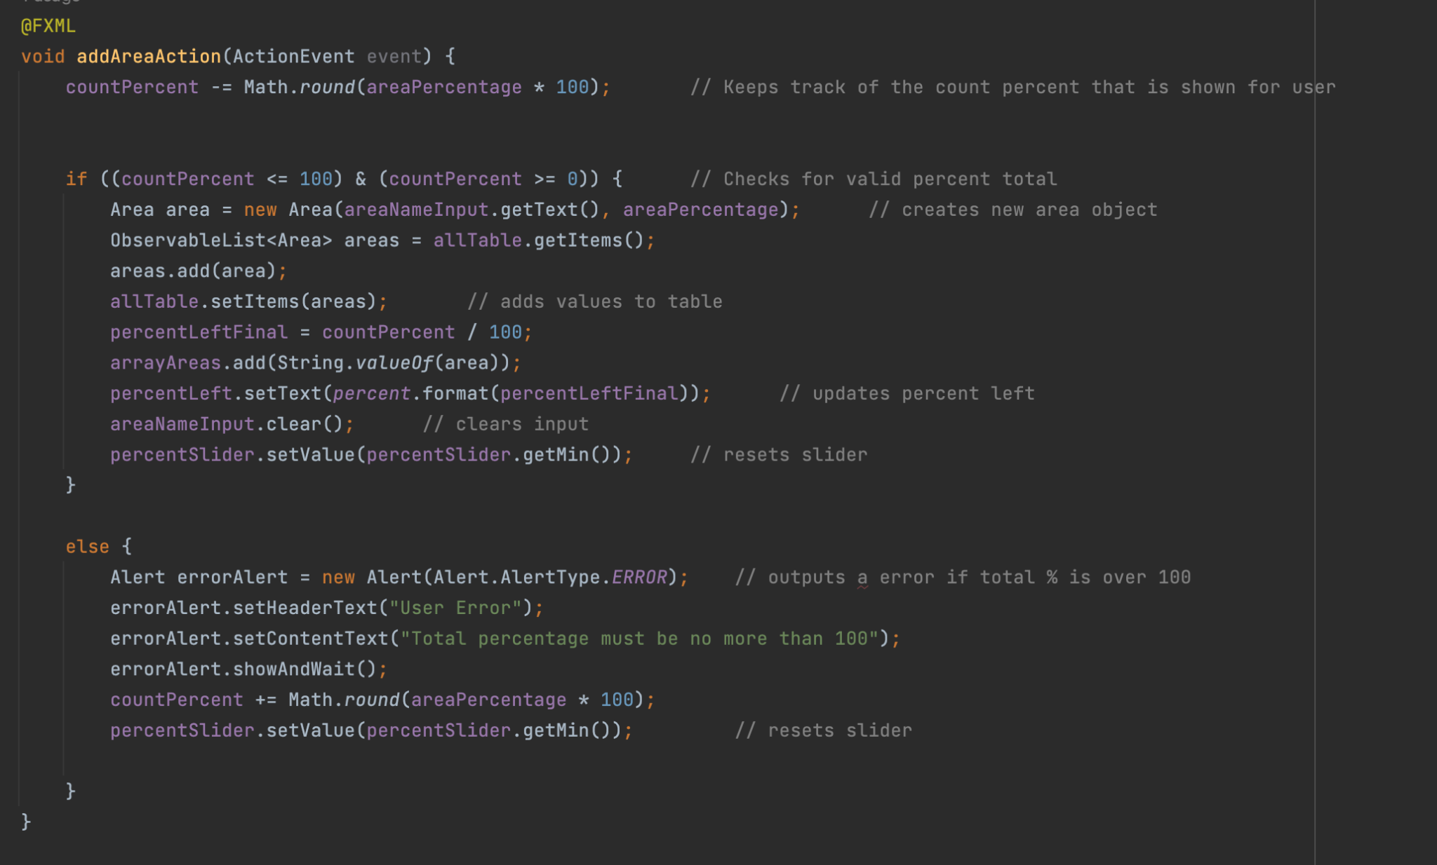
Budget Area

Slide 10
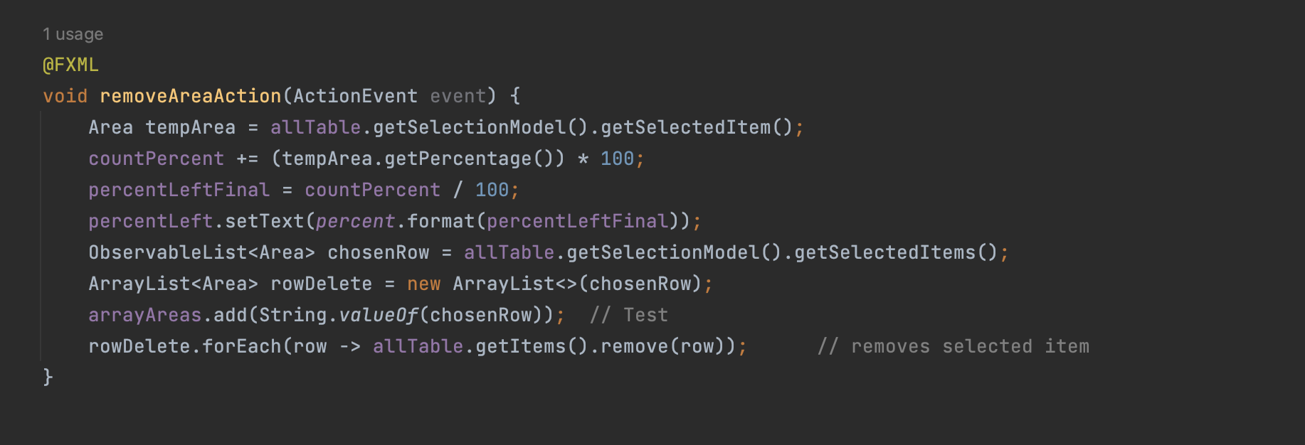
Budget Area

